Slide 1

CHICAGO CRIME ANALYSIS
Ravneet Singh

Slide 2
PROBLEM STATEMENT
One year ago, in response to the high incidence of crime in Chicago, the government launched an operation involving top-performing police officers. As a full year has now passed since the implementation of this operation, it is imperative to assess its effectiveness. This evaluation aims to determine the extent of crime reduction and the benefits derived from the initiative

Slide 3
METHODOLOGY
Data Cleaning: To ensure accuracy and consistency, the Power BI Query Editor was utilized for comprehensive data cleaning
Column Creation : Enhanced analysis was achieved by employing DAX formulas to create additional columns.
Advance Dax Measures: To derive meaningful insights and meet analytical requirements, advanced DAX measures were developed
Visual Creation : Power BI's visualization tools were used to create intuitive visuals, facilitating better understanding and analysis of the data.

Slide 4
DATA OVERVIEW
ID: A unique numerical identifier for each incident record.
Case Number: A unique alphanumeric identifier assigned to the incident.
Date: The date and time when the incident occurred.
Block: The block address where the incident took place, with street numbers partially obfuscated.
IUCR: The Illinois Uniform Crime Reporting code that corresponds to the nature of the incident.
Type: The general category of the crime reported.
Description: A more detailed description of the nature of the crime.
Location Description: The type of location where the incident occurred.
Arrest: Indicates whether an arrest was made (TRUE or FALSE).
Domestic: Indicates whether the incident was domestic-related (TRUE or FALSE).
Beat: Represents the patrol area's code where the incident was reported.

Slide 5
District: The police district where the incident occurred.
Ward: The city ward where the incident occurred.
Community Area: The community area number where the incident occurred.
FBI Code: The code used by the FBI to categorize crimes.
X Coordinate: The X coordinate location data for mapping the incident.
Y Coordinate: The Y coordinate location data for mapping the incident.
Year: The year when the incident was reported.
Updated On: The date and time when the case was last acted upon, either due to an arrest being made or the case being closed for lack of evidence.
Latitude: The latitude where the incident occurred.
Longitude: The longitude where the incident occurred.
Location: The specific latitude and longitude coordinates where the incident occurred

Slide 6
OBJECTIVE ANALYSIS
Data Cleaning: Removed null values, created new columns using DAX formulas.
Crime Type Analysis: Theft identified as most prevalent crime.
Arrest Rate Evaluation: Arrest rate found to be 12.42%.
District Crime Distribution Assessment: District 6 had highest number of reported incidents.
Categorical Attributes: Identified several categorical columns in the dataset.
Handling Null Values: Removed null values from X and Y coordinate columns.
Domestic Crime Proportion Analysis: Domestic crimes account for 20.02% of total crimes.
Location Description Analysis: Apartment locations show highest crime frequency.
Average Time to Resolve Cases: Average time to resolve a case is 9.03 days.
Patrol Area Analysis: Beat 511 identified as having relatively low crime incidence.

Slide 7
SUBJECTIVE ANALYSIS
High-crime areas like Apartment Street need tailored interventions.
Crime rates varied by month and day, suggesting a need for proactive measures.
Arrest rates for domestic crimes were alarmingly low.
Common terms in crime descriptions shed light on prevalent crime types.
Solving times varied based on crime type and location.
Theft was the most prevalent crime type, followed by battery and criminal damage.
Power BI Gateway enables secure data access and real-time analytics.
Strategies for crime reduction included policing, community engagement, and addressing root causes.

Slide 8
INSIGHTS
Most crimes were committed in May 2022.
The most common crime types are theft and battery.
The most affected wards are 42, 27, and 28
Districts 6, and 8 have faced a lot of crimes in the last four months
High crime locations include streets, departmental stores, and apartment areas
The arrest rate is very low for domestic crimes.
The average case-solving time is 9 days.

Slide 9
PROBLEM SOLUTION
Our analysis of crime data for 2022 in Chicago has provided valuable insights into crime trends and patterns. We observed monthly fluctuations in crime rates, identified prevalent crime types, highlighted geographic hotspots, and examined resolution times.
Recommendations:
To improve crime prevention and law enforcement, we suggest:
Targeting policing efforts in high-crime areas to deter criminal activity and enhance community safety.
Strengthening community engagement to foster collaboration in crime prevention.
Utilizing data-driven decision-making to allocate resources effectively.
Investing in technology and infrastructure for enhanced security.
Collaborating with social services to address underlying factors contributing to crime.
By adopting a proactive, multi-faceted approach, we can work towards a safer Chicago.

Slide 10
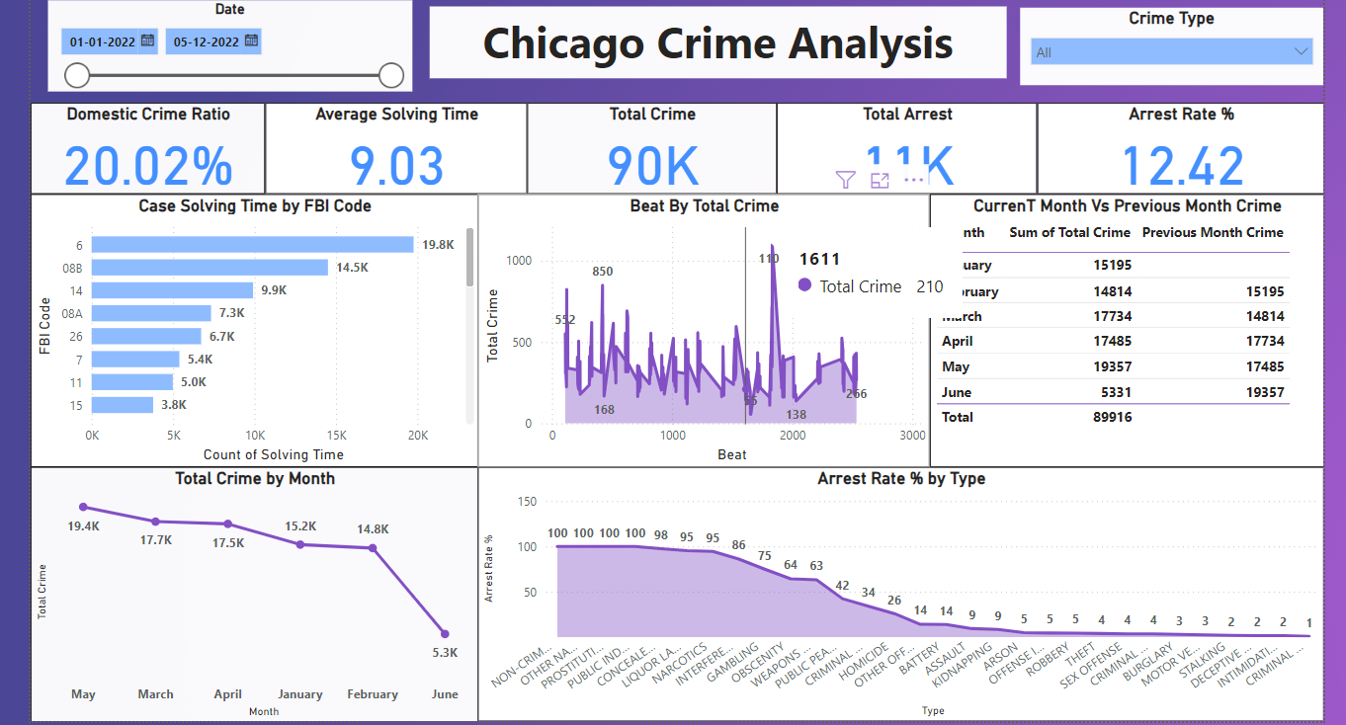
MAIN TAB

Slide 11
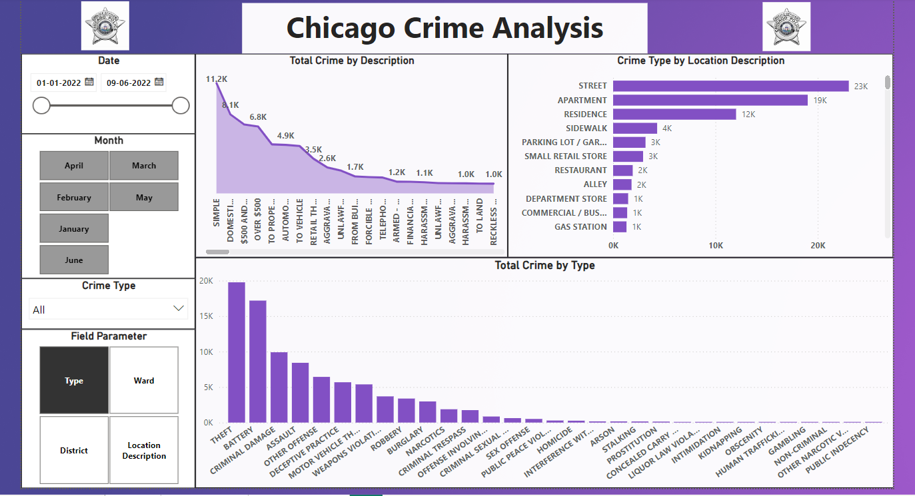
LOCALITY TAB

Slide 12
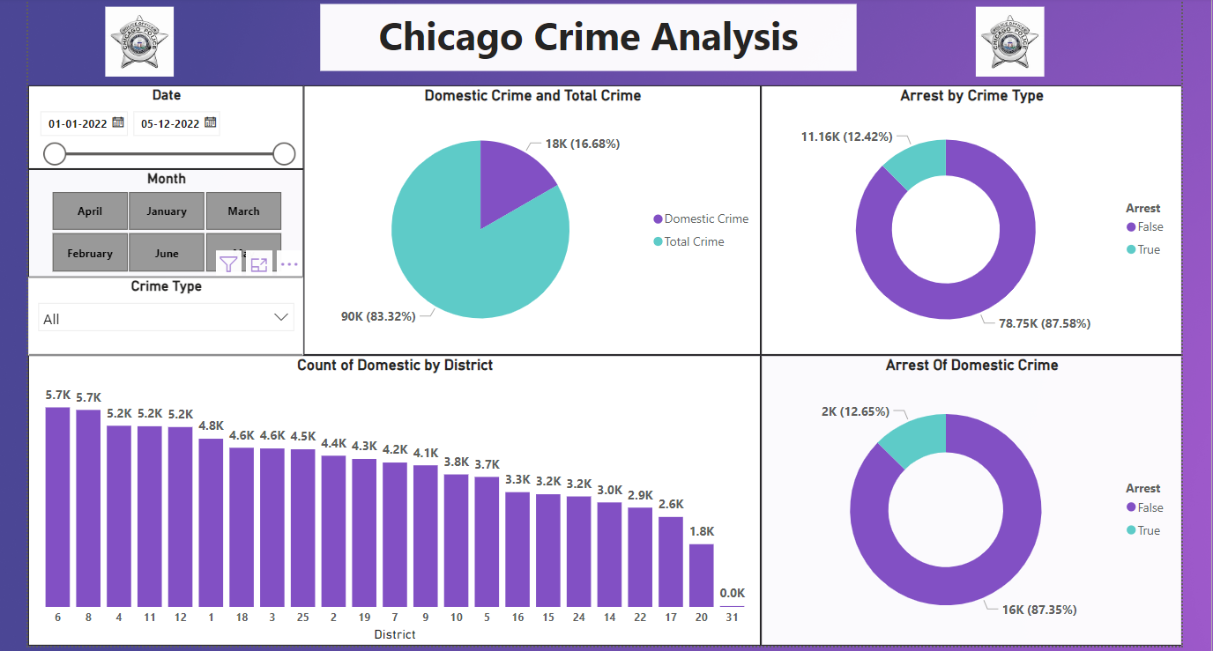
EXPLORATION TAB

Slide 13
THANK YOU

